Slide 1
Low Downside Risk, Great Upside
DIMITRIOS KOUTSOUBOS
Show me the Value London Value Investing Club
February 6, 2019

Slide 2
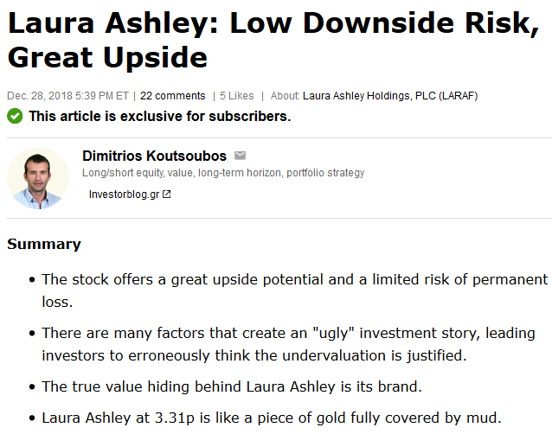
The laura Ashley story
International lifestyle brand retailing furniture, home accessories, decorating and fashion products.
161 retail stores in the UK, Ireland, France. Franchise operations in 29 other countries
The company went public two months after the tragic death of Laura Ashley in 1985. (135p per share) - £270 million

Slide 3
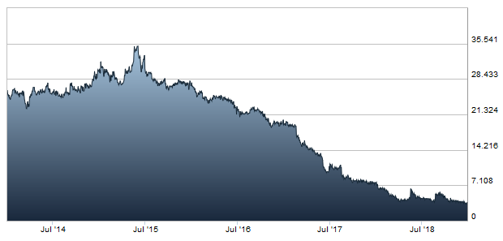
Problems during the 90’s & MUI
Overexpansion => North American operations problems
Laura Ashley was rescued in two periods (1991, 1999-2003)
200 million shares => 728 million shares, £109 million
MUI Group controls 61%
Since 2004: Earnings of 20.7p per share, dividends of 19.75p per share
Shares trading above 30p during 2015

Slide 4
The extreme undervaluation
Revenue ≈ £250 million
Brand Power ≈ £500 million
Online Revenue: £60 million
Earnings Power
£8.8 million for 3.4% net margin
Former shareholders value during MUI rescuing
£35 million
Stock Price: 3.31p
Market Capitalization
£24 million
Price to Sales: 0.09x

Slide 5
Scenarios & valuation
THE GOOD SCENARIO
THE BAD SCENARIO
“BLACK SWAN”
Earnings Power: £8.8 million
Market Cap for Earnings Power=12.5x:
£110 million
New Rescuing
Issuance of shares
Current Shareholders
0p
£35 million
50%
30%
20%
£64 million or 8.8p per share
167%
Current Price: 3.31p
Current Capitalization: £24 million
Upside Potential

Slide 6
The “ugly” & the catalyst
Low Book Value: £36 million, (debt to equity, price to book) - BRAND VALUE
The Singapore Property: £4.7 million impairment charge - NET DEBT FREE
The loss: -£1.4 million - UNDERLYING PBT (£5.6 million)
Dividend Suspension – FOCUS ON SURVIVAL, RE-INITIATION IN FUTURE
UK, Brexit, Pound, Retail environment – FACTORS FOR SURVIVAL, SYSTEMIC RISKS
Malaysian Management & Ownership – GREAT PAST ABILITIES
Closing Stores and Dying Brand – CLASSIC BRAND, RETURN TO FASHION
Throwing good after bad money, falling knife – VALUE INVESTORS SHOULD
CATALYST: FY 2019 Half-Year results – Net debt free

Slide 7
In few words
Brand Power of £500 being sold for £24 million
Great Upside Potential, Low Downside risk
— 167% upside, 8.8p per share —
Many great reasons for undervaluation – An “ugly” story
The EMV fair value calculation takes into account those risks
Half-Year results may act as catalyst
“Laura Ashley at 3.31p is like a piece of gold fully covered by mud.”

Slide 8
Thank you!
Feel free to send me your thoughts at info@investorblog.gr
en.investorblog.gr

