Slide 1
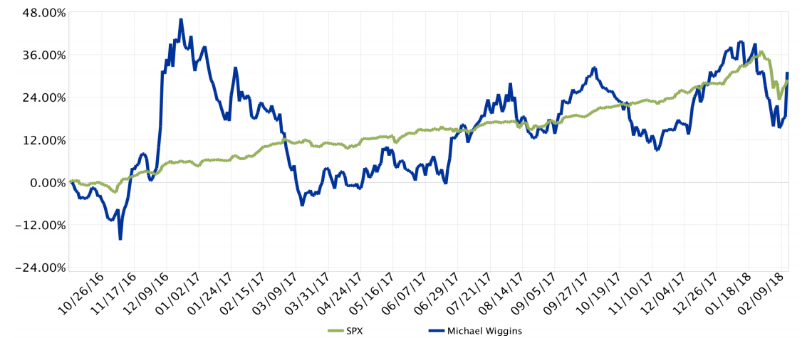
LDVIC 31.22% vs S&P500 28.97% (diff. +2.25%)

Slide 2
DISCLOSURE

Slide 4
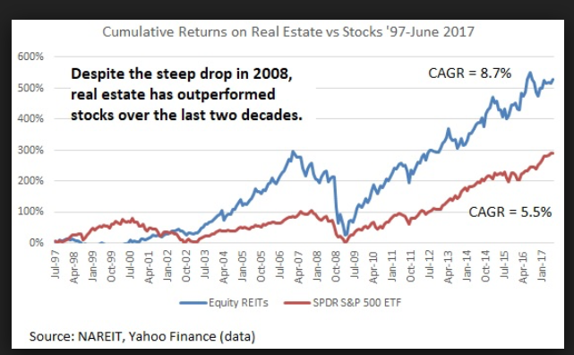

Slide 5
Passive Investing

Slide 6
Investor Psychology :
The best investment analyst is going to be right two out of three times (TEMPLETON)

Slide 7
Investment Rules (MWO):
Investing is a full time job. No if, not buts, no excuses. Buy ETFs

Slide 8
1) What is Risk?

Slide 9
Investing is really simple and not overly complicated. It is mostly down to price.
Don’t overpay!

Slide 10
Competition

Slide 11
Look for companies that generate FCF.

Slide 12
LOOK AT THE TREND ON THE NUMBER OF SHARES OUTSTANDING

Slide 13
Compare how it was priced in the past?

Slide 14
Who owns the stock?

Slide 15
2) How many positions in the portfolio?

Slide 16
3) How often to rebalance?

