Slide 2
Important information
This presentation is not directed at or intended for publication or distribution to any person (natural or legal) in any jurisdiction where doing so would result in contravention of any applicable laws or regulations. This information does not constitute an offer or solicitation in any jurisdictions in which such an offer or solicitation is not authorised or to any person to whom it is unlawful to make such an offer or solicitation. The information herein is not for distribution and does not constitute an offer to sell or the solicitation of any offer to buy any securities in the United States to or for the benefit of any United States person (being residents of the United States or partnerships or corporations organised under the laws hereof). None of the products listed in this presentation have been registered in the United States under the Investment Company Act of 1940 and interests therein are not registered in the United States under the Securities Act of 1933. Prospective investors should take appropriate independent investment advice and inform themselves as to applicable legal requirements, exchange control regulations and taxes in the countries of their citizenship, residence or domicile.
Risk Warning
There are risks associated with the investments that may be outlined in this presentation. Past performance is not a guarantee of future performance. The price of assets can go down as well
as up and may be affected by many variables such as changes
in interest rates and rates of exchange. An investor may not get back the amount invested. An investor may not receive any income distributions such as dividends or coupon payments.
The investment opportunities are illiquid and involve long term
investment horizons. This presentation is published solely for information purposes and does not constitute an offer, investment, legal, tax or other advice nor is it to be relied upon in making an investment decision. Information contained herein has been taken from sources considered by WiseAlpha Technologies Limited to be reliable but no warranty is given that such information is accurate or complete and it should not be relied upon as such. WiseAlpha Technologies Limited will not be responsible for any loss or damage of any kind which arises, directly or
indirectly, and is caused by the use of any part of the information
provided. The investment opportunities we offer are only available to qualifying persons or legal entities as defined by your local regulator and on the basis that you are not subject to any jurisdictional restrictions prohibiting access to the information in this presentation.
WiseAlpha Technologies Limited (FRN: 751087) Is authorised and regulated by the Financial Conduct Authority in the UK. WiseAlpha Technologies Limited is a company registered in England, with its registered
office at Level 39, 1 Canada Square, London E14 5AB(Company No.
08967521).WiseAlpha Technologies Limited is registered with the Office of the Information Commissioner (Reg no. ZA051908).

Slide 3
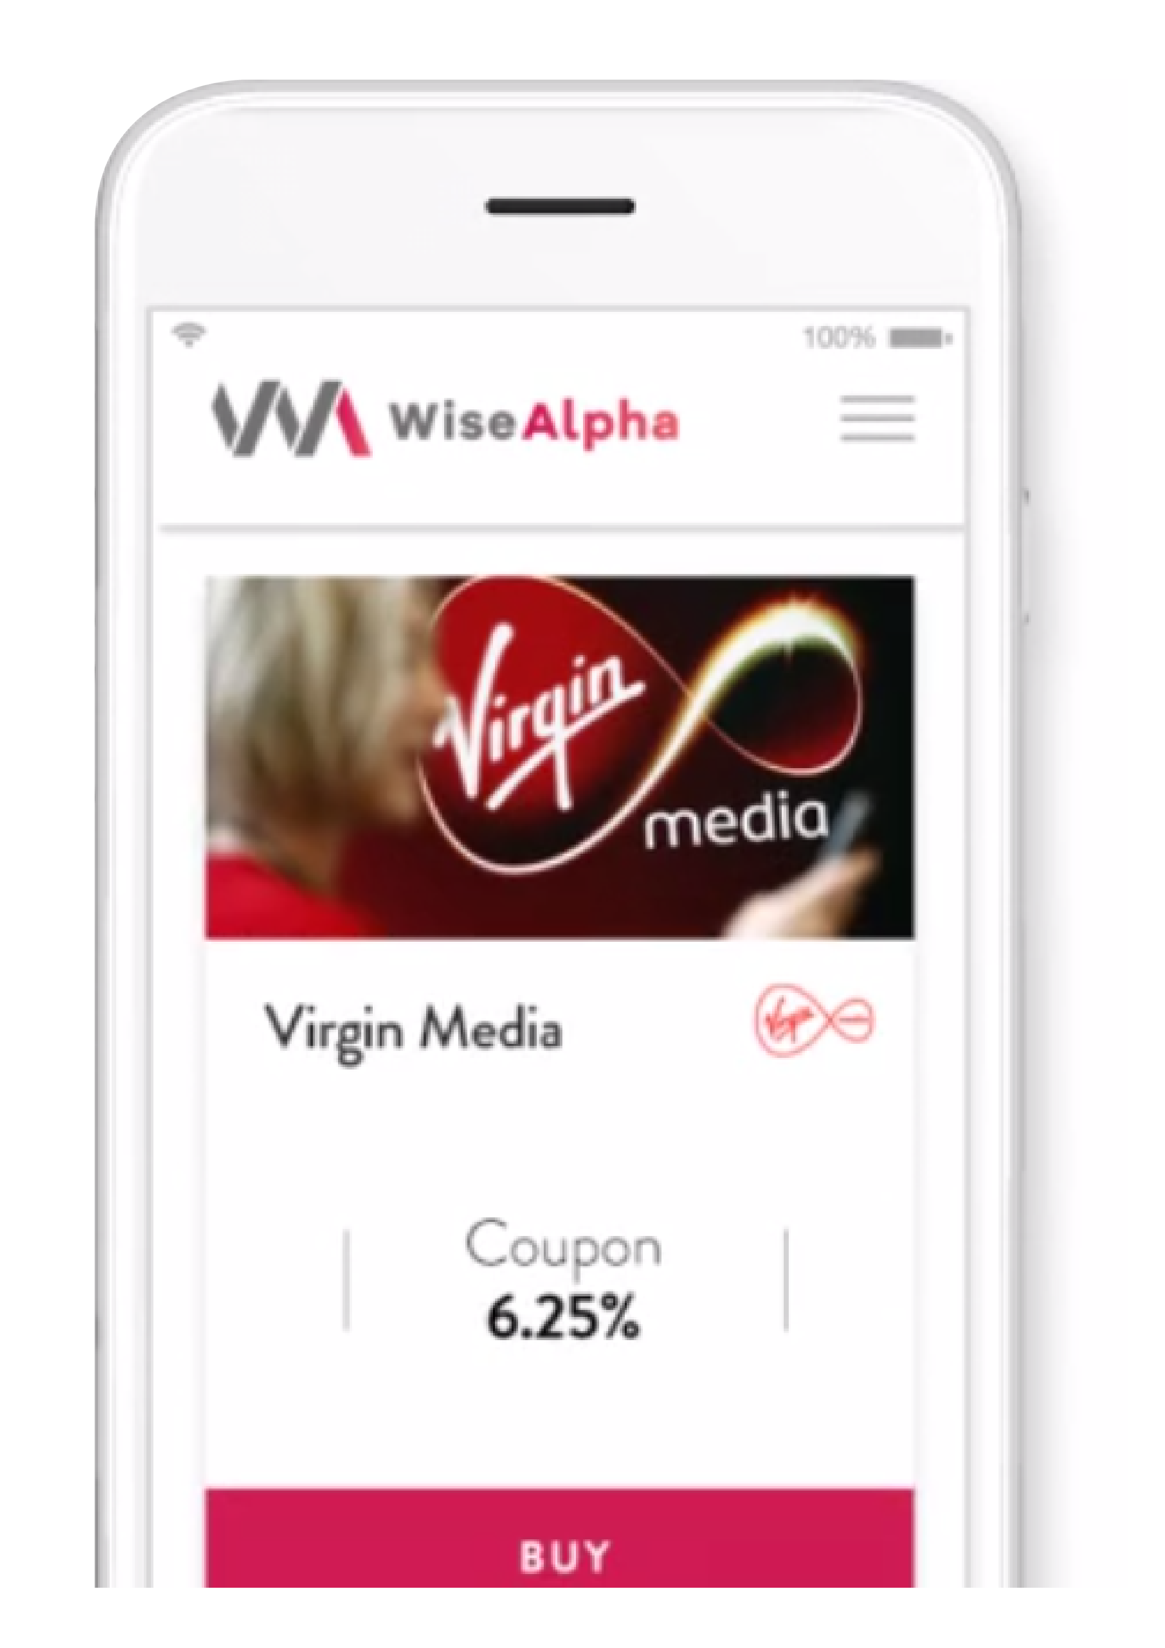
WHAT IS WISEALPHA?
AUTOMATED DIGITAL BOND MARKET
Makes senior secured and high yield corporate bonds* accessible to retail investors in £100 ticket size, £0.01 thereafter
>100 corporate bond issues such as Vodafone, Pizza Express, RAC, Virgin, The AA and Ocado
Floating & Fixed R ate with yields between 3 -15%
Automated investing tool RobowiseTM
Premium fixed income product for the mass retail market versus P2P and retail bond alternatives
Only regulated online UK (and in the world) marketplace for all types/sizes of investors
SMART MONEY.
SMART INTEREST.
*References to bonds are WiseAlpha Notes which correspond to digitised fractions of each corporate bond

Slide 4
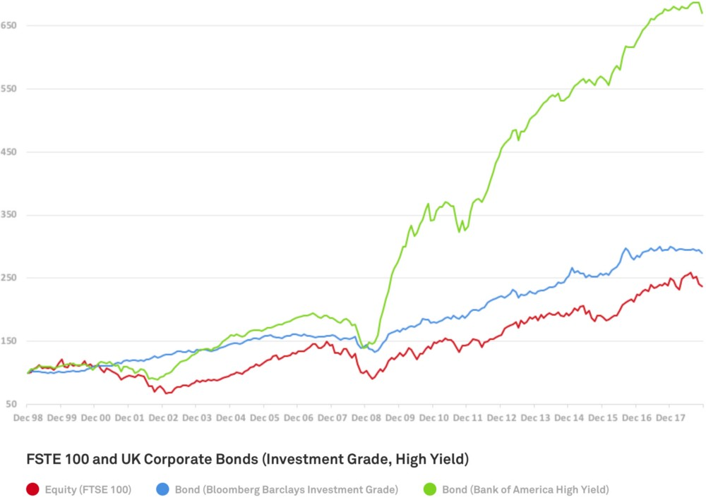
Corporate bonds have outperformed equities
Structure Points
Astonishingly, both investment grade and high yield bonds have outperformed UK equities over the last 20 years both in terms of returns and price volatility
The BofAML Sterling High Yield Bond Index has returned 8.9% per annum while the FTSE 100 Total return index returned only 3.6% per annum at the end of 2018
WiseAlpha views corporate bonds superior as an asset class than equities, and with Brexit vote uncertainty leading to a drop off in bond prices, there is an opportunity for earning high single digit and even double digit returns on bonds over the medium term

Slide 5
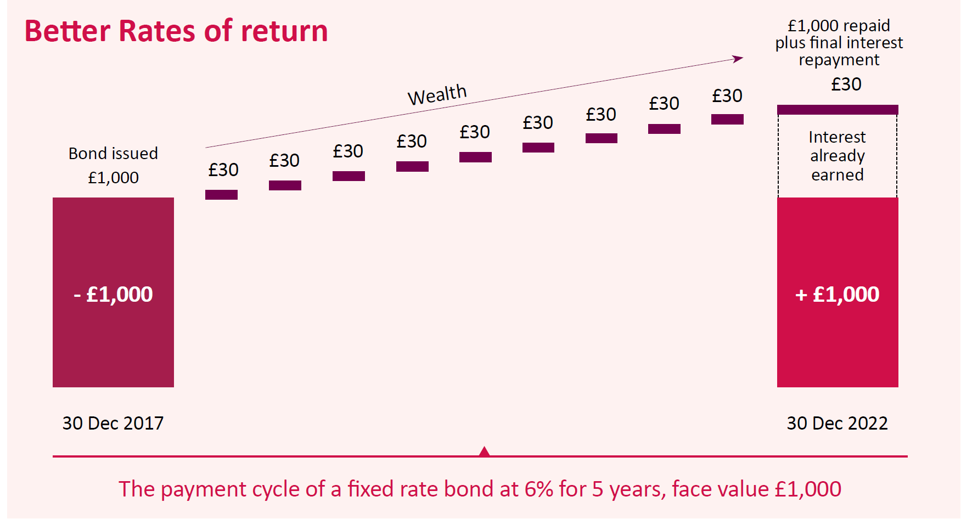
Basics of a bond
Structure Points

Slide 6
Comparison versus equity
Structure Points

Slide 7
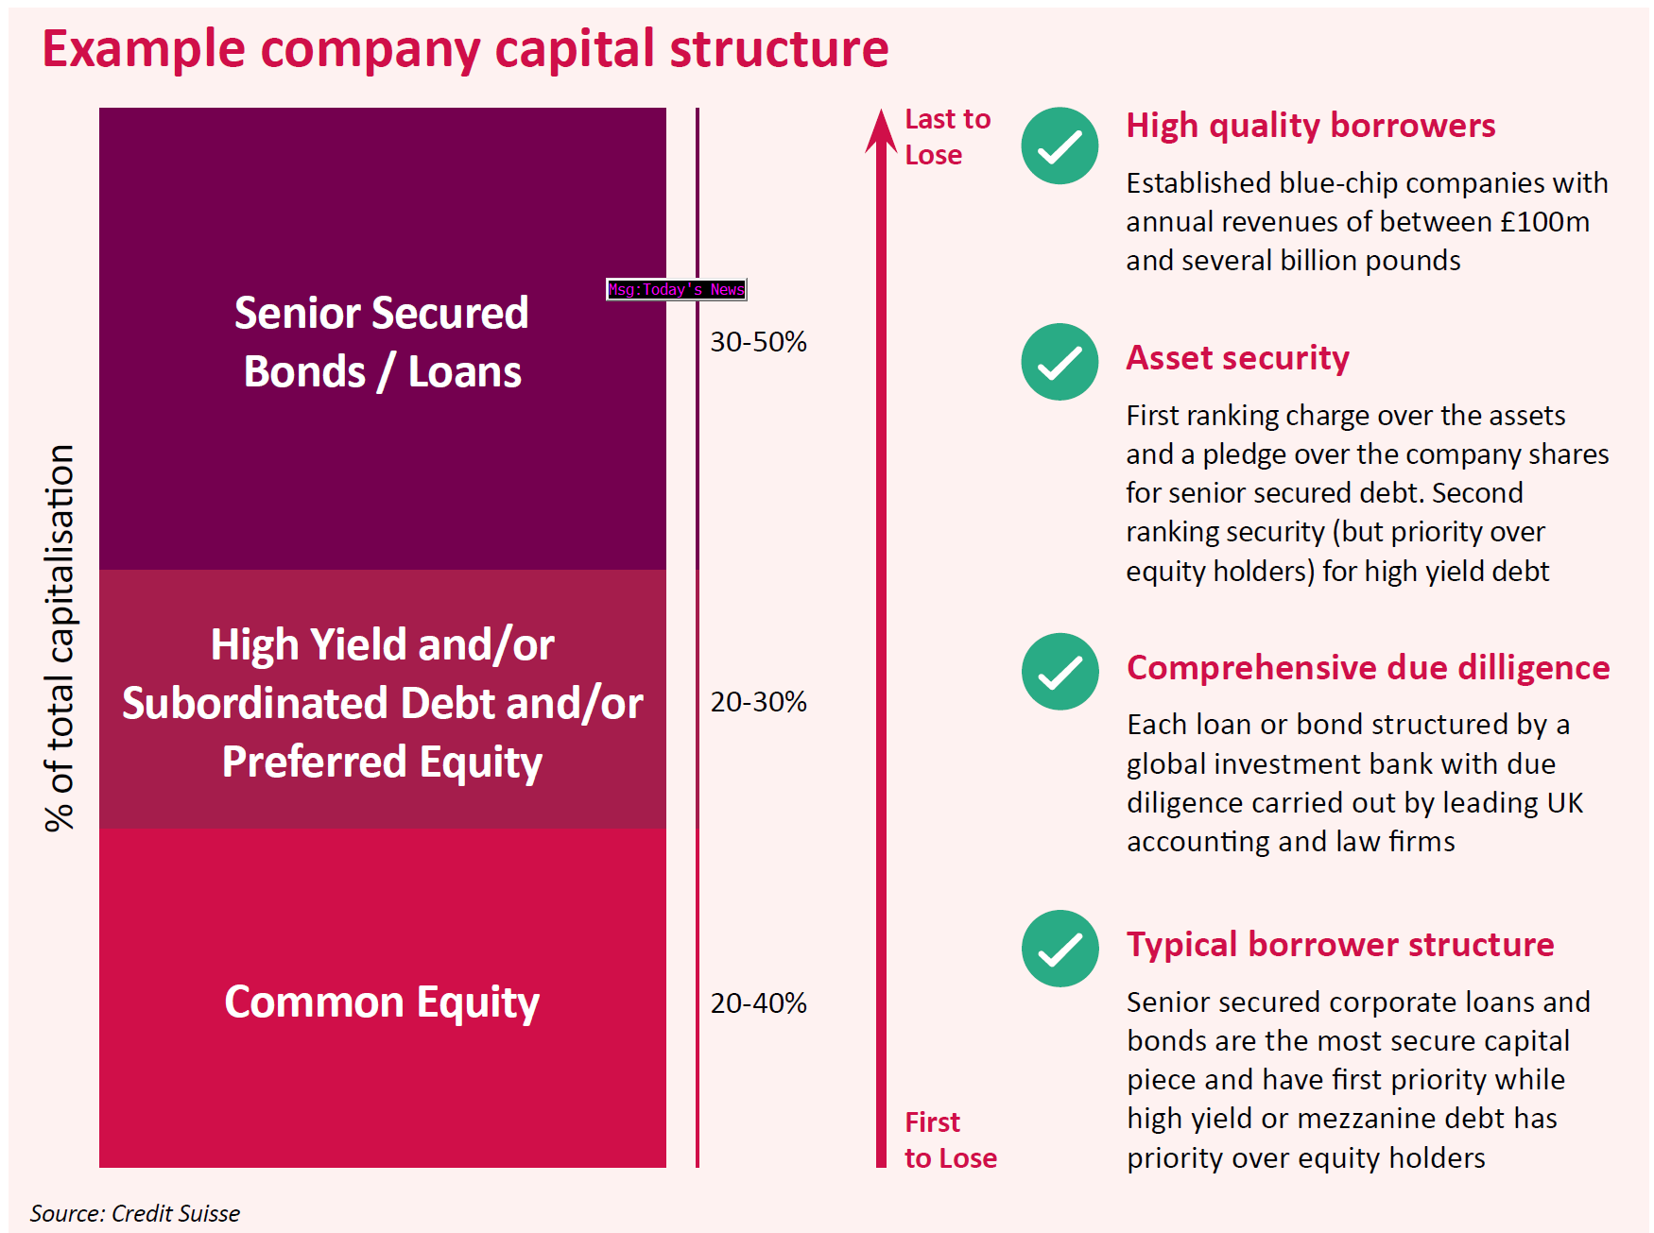
Example capital structure of a company
Structure Points

Slide 8
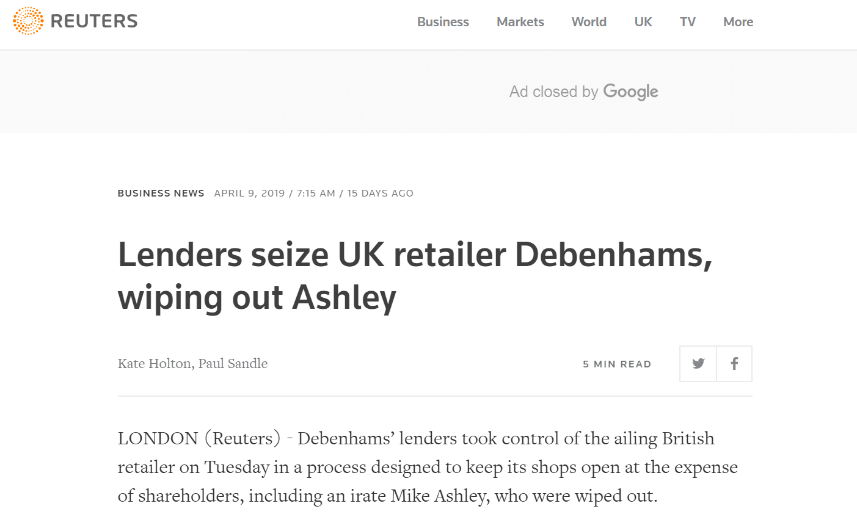
Case study:
Equity holders wiped out.
Shares at zero
Property Leaseholders forced to take a cut (CVA)**
Bond holders receive equity in the new private company**
Old bonds will continue to be serviced.
Currently trading at 40 pence
**This process is ongoing & fluid

Slide 9
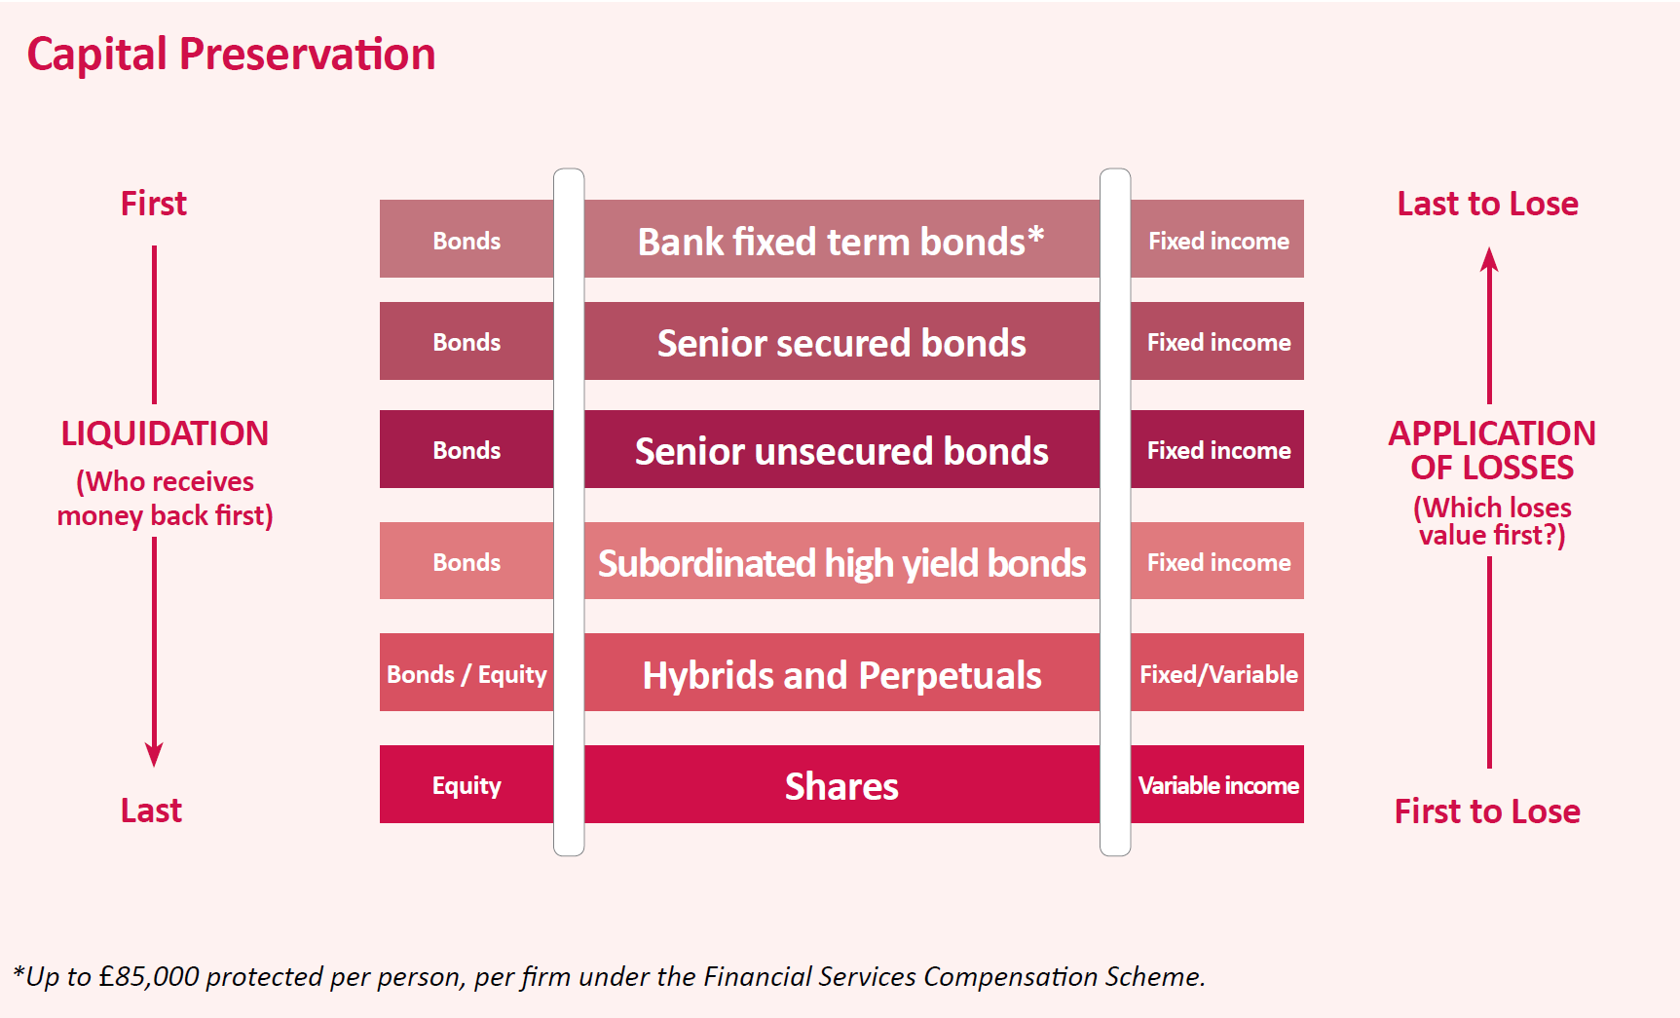
Types of bond
Structure Points

Slide 10
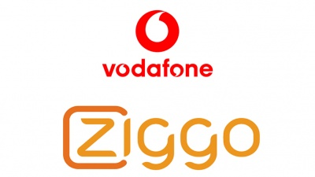
PREMIUM CORPORATE FOCUS

Slide 11
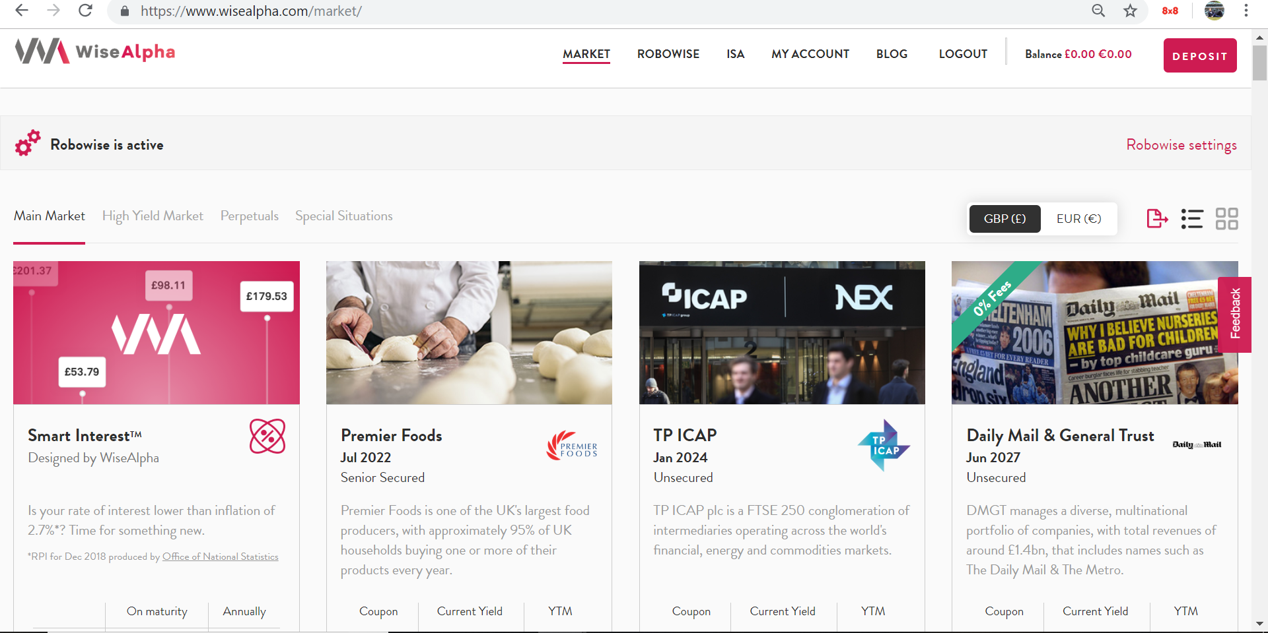
Our Website & Promo Code
Use the code ‘CITYFALCON’ to receive a £10 welcome bonus

Slide 12
Any Questions?

Slide 13
THANK YOU

