Slide 1
PRESENTATION BY STEPHEN GOLDING
Fulham Shore plc
LON:FUL

Slide 2
Owns and operates two restaurant chains
36%
revenues
64%
revenues

Slide 3

Restaurant industry:
Characteristics
Stable gross margins, race for sales
Popularity of concepts is key
No moats
Chains gaining share from independents
Durable product

Slide 4
Thvdfghgfsqa
16
£18.1m
£718k
Restaurants
Revenues
Operating Profit

Slide 5
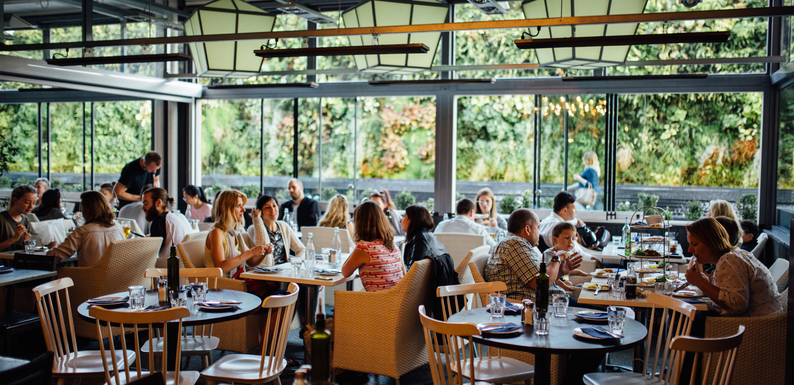

Slide 6
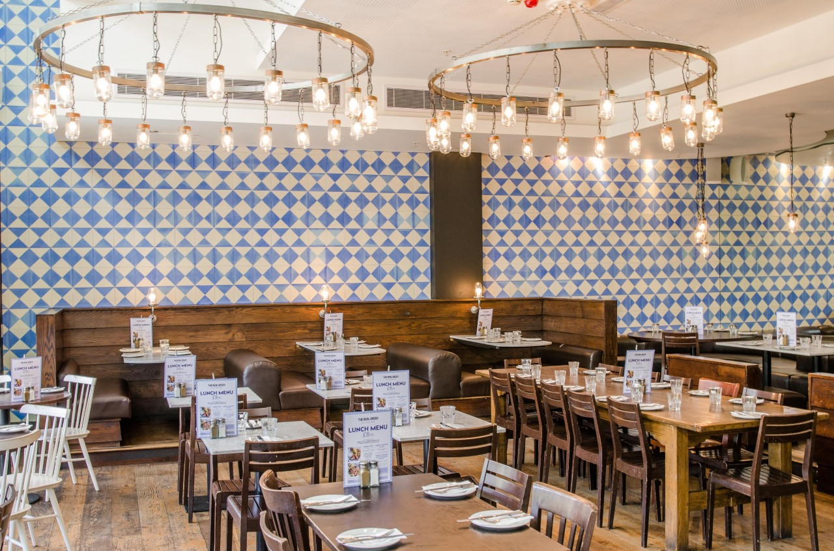

Slide 7
The Real Greek: History
Jane Doe
Founded in London in 1999
Jane Doe
Grown slowly over the years
Only UK-based Greek chain

Slide 8
The Real Greek: Concept
Jane Doe
Hot or cold Meze-style smaller dishes
Jane Doe
Lunch menu £8.50, Meze dishes £4-£7
John Doe
Outdoor dining

Slide 9
Thvdfghgfsqa
43
£36.5m
£78k
Restaurants
Revenues
Operating Profit

Slide 10
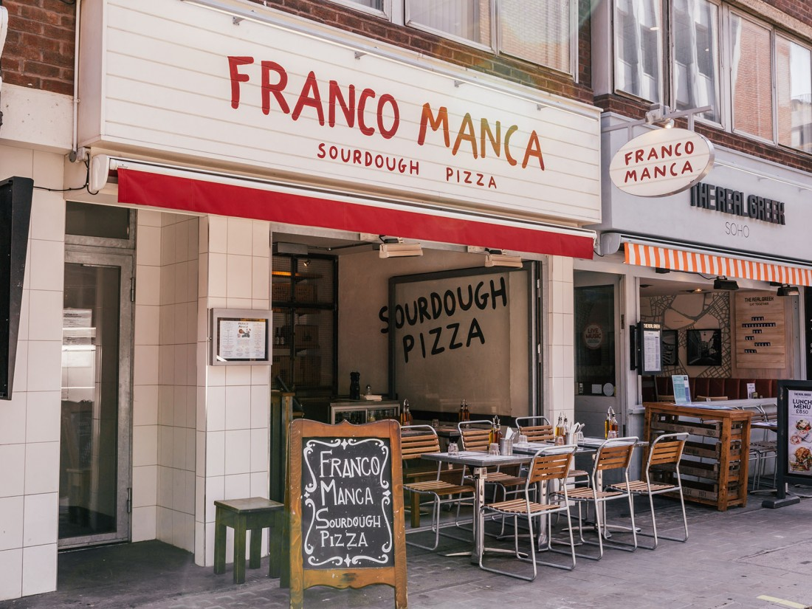

Slide 11
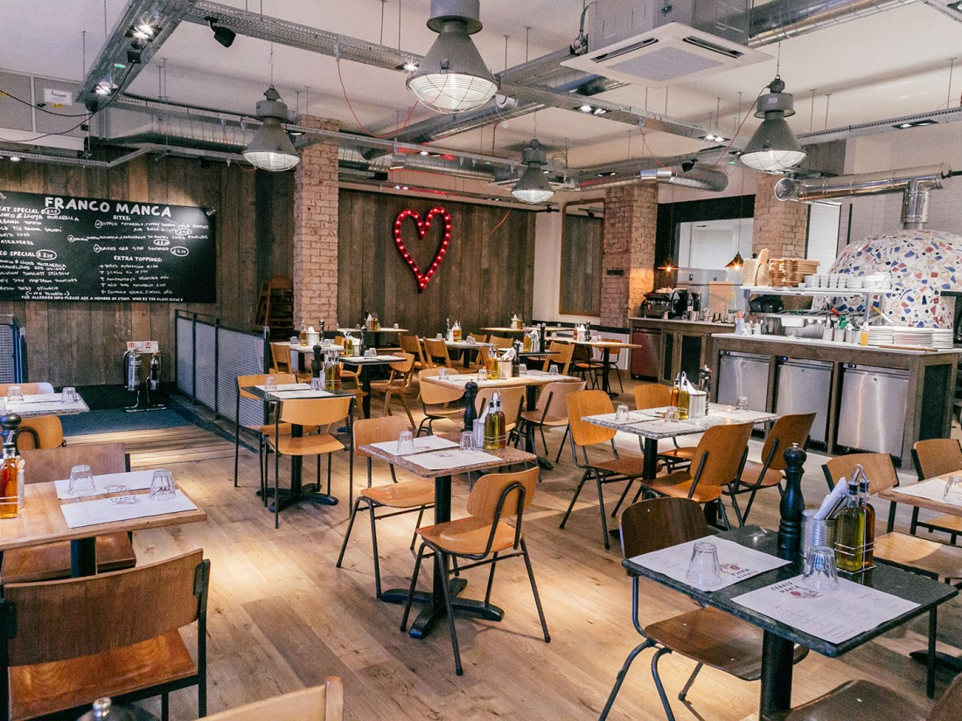

Slide 12
Franco Manca: History
Jane Doe
Founded in Brixton in 2008
Jane Doe
Grown rapidly, especially from 2015-2017
All but 9 restaurants London-based

Slide 13
Franco Manca: Concept
Jane Doe
Small menu, fresh ingredients
Jane Doe
Pizzas £5-£8. No discounts
Quick service, workmanlike decor

Slide 14
Franco Manca:
v. Pizza Express
 | Franco Manca | Pizza Express
Price | 30%+ cheaper
Variety of menu |  | More variety
Freshness of ingredients | Fresher
Setting |  | More pleasant decor

Slide 15
Fulham Shore: Management
 | % ownership | Role
DM Page | 14 | Chairman
NAG Mankarious | 20 | Managing Director
NJ Donaldson | 2 | Company Secretary
NCW Wong | 2 | Finance Director
MA Chapman | 0 | Non-executive Director
DAL Gunewardena | 0 | Non-executive Director

Slide 16
Fulham Shore:
Valuation
£60m market capitalisation +
£12.4m debt -
£0.4m cash
  = £72m enterprise value
Per restaurant = £1.2m
Wagamamas bought for £4m per restaurant

Slide 17
Fulham Shore:
Valuation
Operating profit £0.1m +
Pre-opening costs £1.2m +
Amortisation of brand £0.8m +
Costs of closing store and brand £1m
= Steady-state profits £3.1m
/£72m enterprise value
= x23 current profits

Slide 18
Fulham Shore:
Risks
Concept has already become impaired
Concept only works in London
Concepts become impaired

Slide 19
Fulham Shore:
My Valuation
150 restaurants
£150m revenue x
£0.1 profit per restaurant
=15m profits

Slide 20
PRESENTATION BY STEPHEN GOLDING
Fulham Shore plc
LON:FUL

