Slide 1
How to do investment research
Trung Nguyen
10 May 2018

Slide 2
Company Research
Start-ups / Private companies
Publicly listed

Slide 3
Start-up
Idea (macro)
Market potential (macro)
Team – execution capability (face-to-face, background check)

Slide 4
Listed companies
Sources in order of reliability:
SEC filings (focus)
Industry reports and database
Company websites
News and press releases

Slide 5
SEC Fillings
10-K, 10-Qs, 8K (essential)
Earnings call (essential)
Form 4
Transaction codes
P: Purchase open market
S: Sell open market
A: Award / grant
F: Tax liability
J: Other
V: Voluntary
Form 13G: Passive
Form 13D: Active

Slide 6
Industry reports
Morning Star
Stockrow
Insidercow (Double check with Form 4)
Shortsqueeze
…etc…
*risk of errors is low but double check with 10-Ks/10-Qs

Slide 7
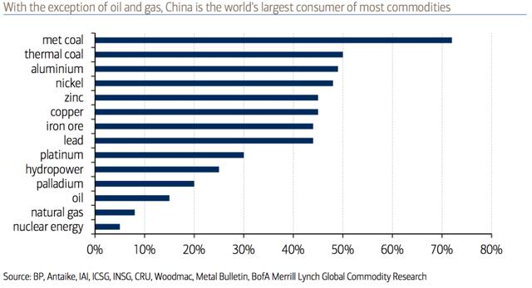
Example 1: Shipping
Industry brief: Highly cyclical, capital intensive, shady corporate governance
90% of world trade is facilitated by shipping
25% is to and from China, few dry bulk are over 50%

Slide 8
Example 1: Shipping
Interested in:
Company fundamentals,
Future outlook for freight rates (supply & demand of transport capacity),
Corporate governance - management history
"If you don't know jewellery, make sure you know the jeweller.“ W.Buffett

Slide 9
Example 1: Shipping
Fundamentals and corporate governance
10K, 10Q (fundamentals and management history)
Compare ‘management words/spins’ at earnings calls (management honest test)
Website for ship positioning, trade routes and announcements

Slide 10
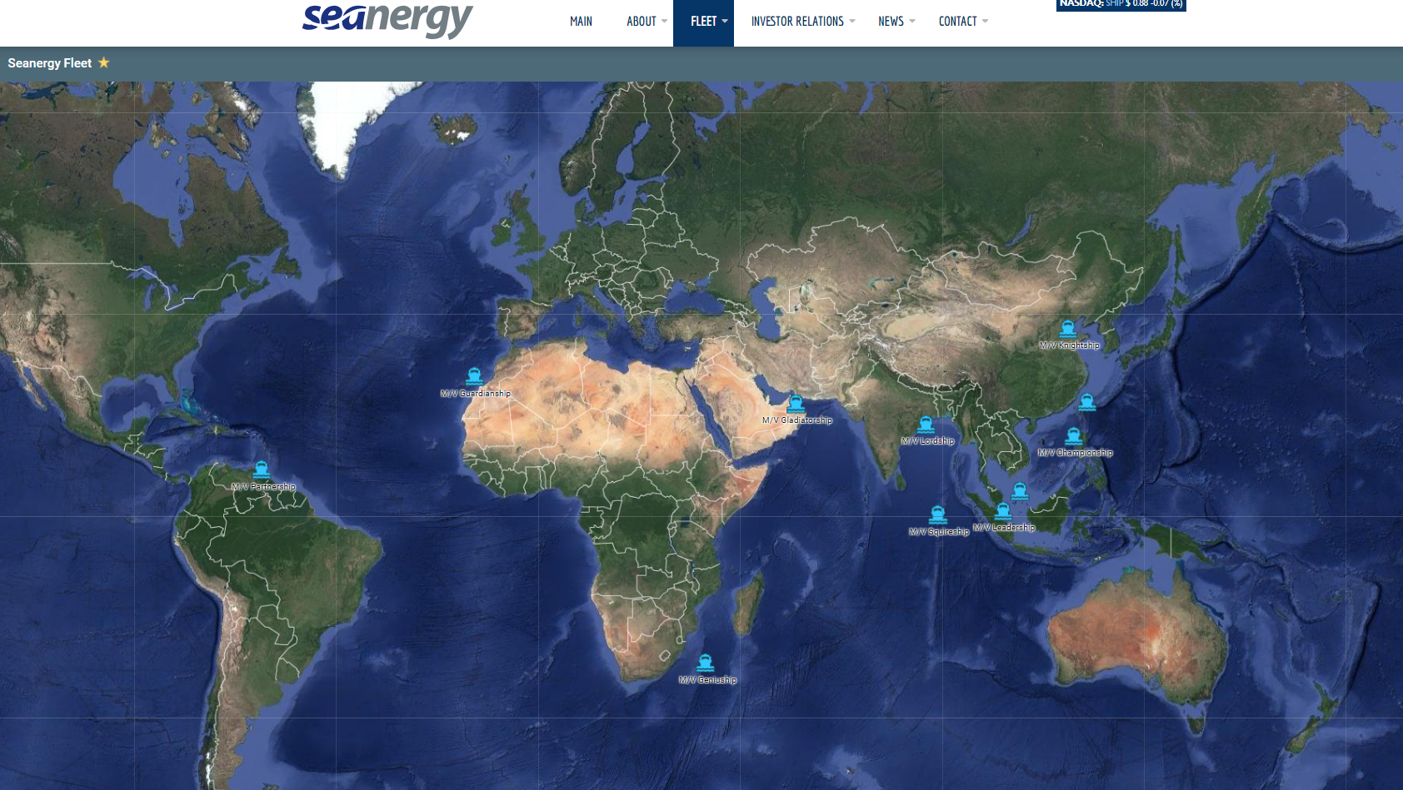

Slide 11
Example 1: Shipping
Supply (fleet size) and Demand (global GDP)
Industry reports
Hellenicshipping (weekly rates, new ship values, scraps, demolition)
Tradewinds, Splash247 (similar but more on news)
Hegnar, Bloomberg (BDI rates)
Vesselvalue (free on Twitter but delayed data)
Bellwether! (SBLK, SALT, VALE, Rio Tinto mining)

Slide 12
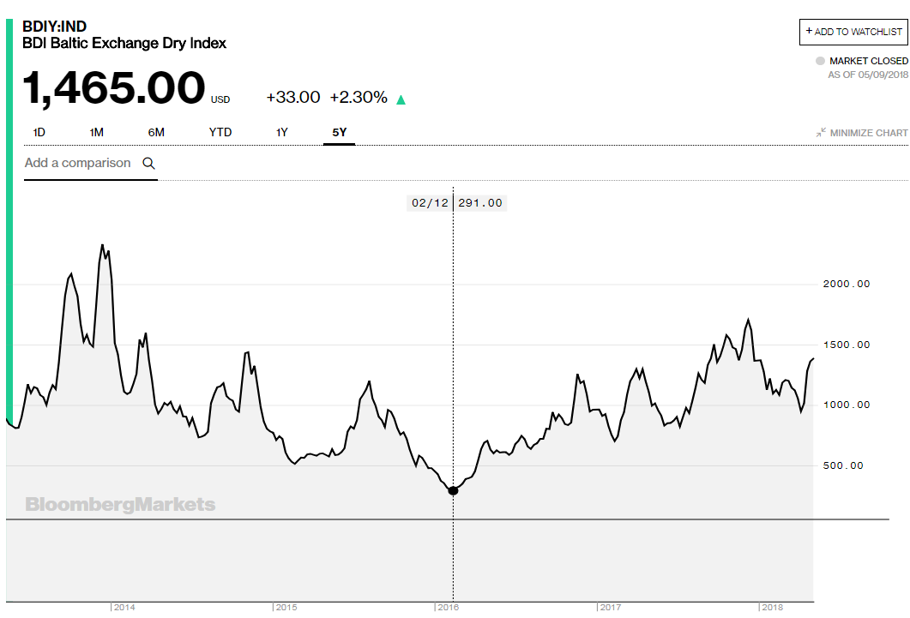

Slide 13
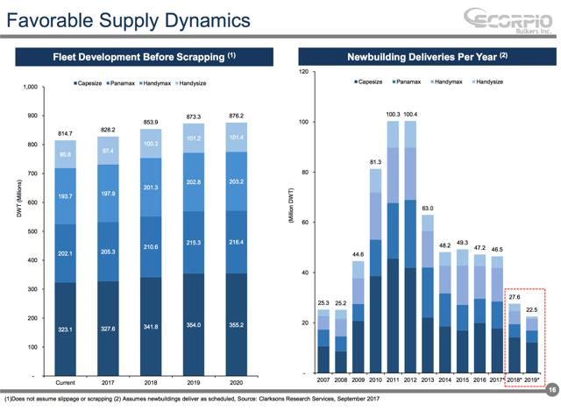
Example 1: Shipping
We have around 828mil of DWT of carrying capacity in the water in 2017, and we expect to have an extra 27.6mil in 2018 and 22.5mil in 2019. This represents an increase of 3% and 2% respectively
*do not take into account of the likely cases of shipbuilding delays, non-delivery, slippage and the scrapping of old vessels.

Slide 14
Other examples
LB Foster: US Freight rail flow
Fossil: Channel check – anecdotal, talk to shop managers
GNC: Same, Website prices vs Amazon
US Auto Parts: USCourts.gov – existing customs issues
Note: Read lots of earnings calls from competitors too. Clues about Fossil performance came from Fitbit smart watches performance etc.

Slide 15
Reading
The Dhandho Investor – Monish Pabrai
Stock Market Genius – Joe Greenblatt
Intelligent Investor – Ben Graham
5 Rules - Pat Dorsey
Margin of Safety - Seth Klarman
Creative Cash Flow – Mulford & Comiskey
Shareholders letters – Amazon, Berkshire…
…..and more

Slide 16
Contacts
Seeking Alpha – DTF Capital
Performance since inception (April 2017) is 20%
www.dtfcapital.co.uk

