Slide 1
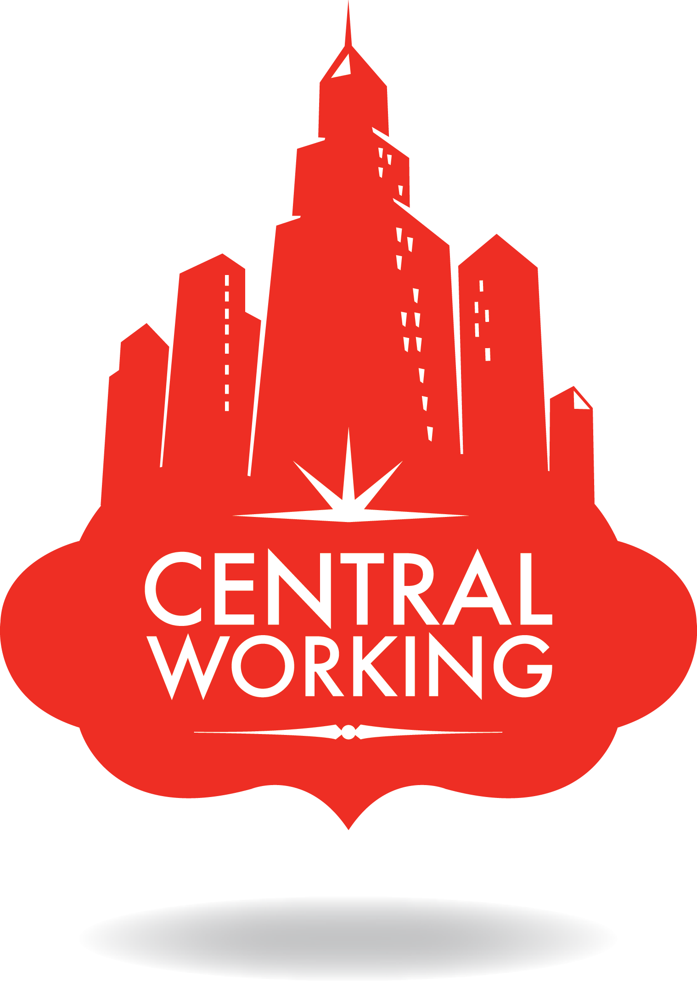

Slide 3
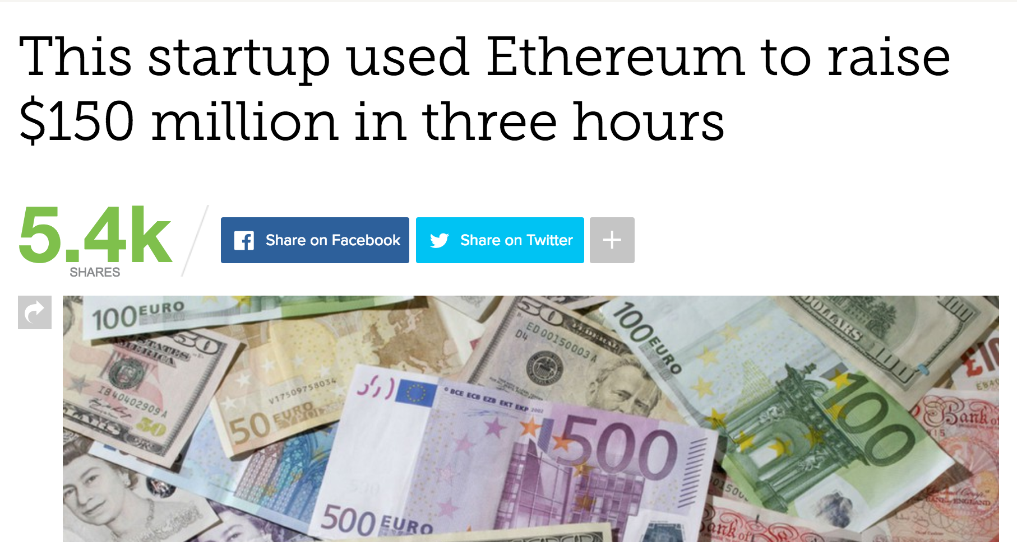

Slide 4
“An ICO is what you get if bitcoin and Kickstarter had a baby — a crowdsale of a new crypto asset (with a cryptocurrency like bitcoin being one type of crypto asset) that powers some kind of peer-to-peer blockchain network.
They enable new business models. They are making a lot of money for the developers and entrepreneurs who are launching them. And we’re not really sure how legal they are.
But there is a lot of speculative activity, irrational exuberance and activity we would call illegal if this were something that was regulated by the SEC — and so far they’ve kept mum about the subject.”
- Laura Shin, Forbes

Slide 5
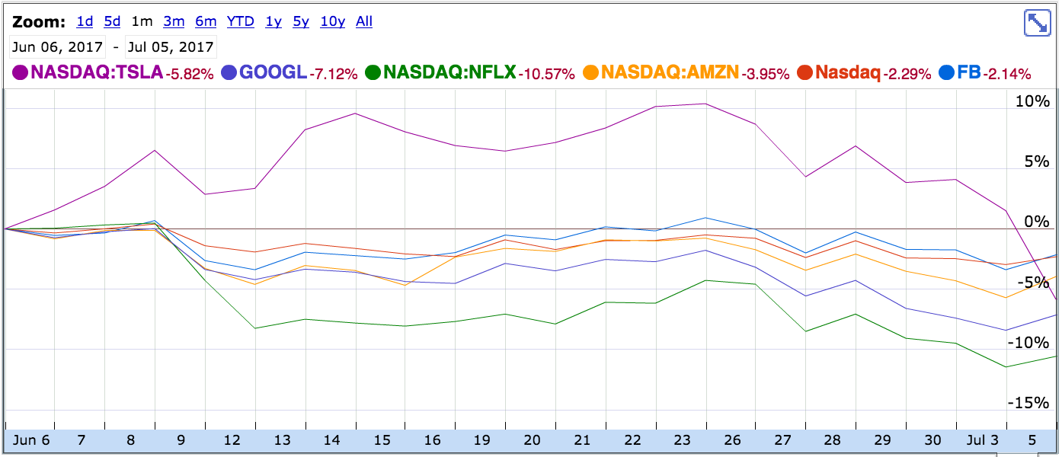

Slide 6
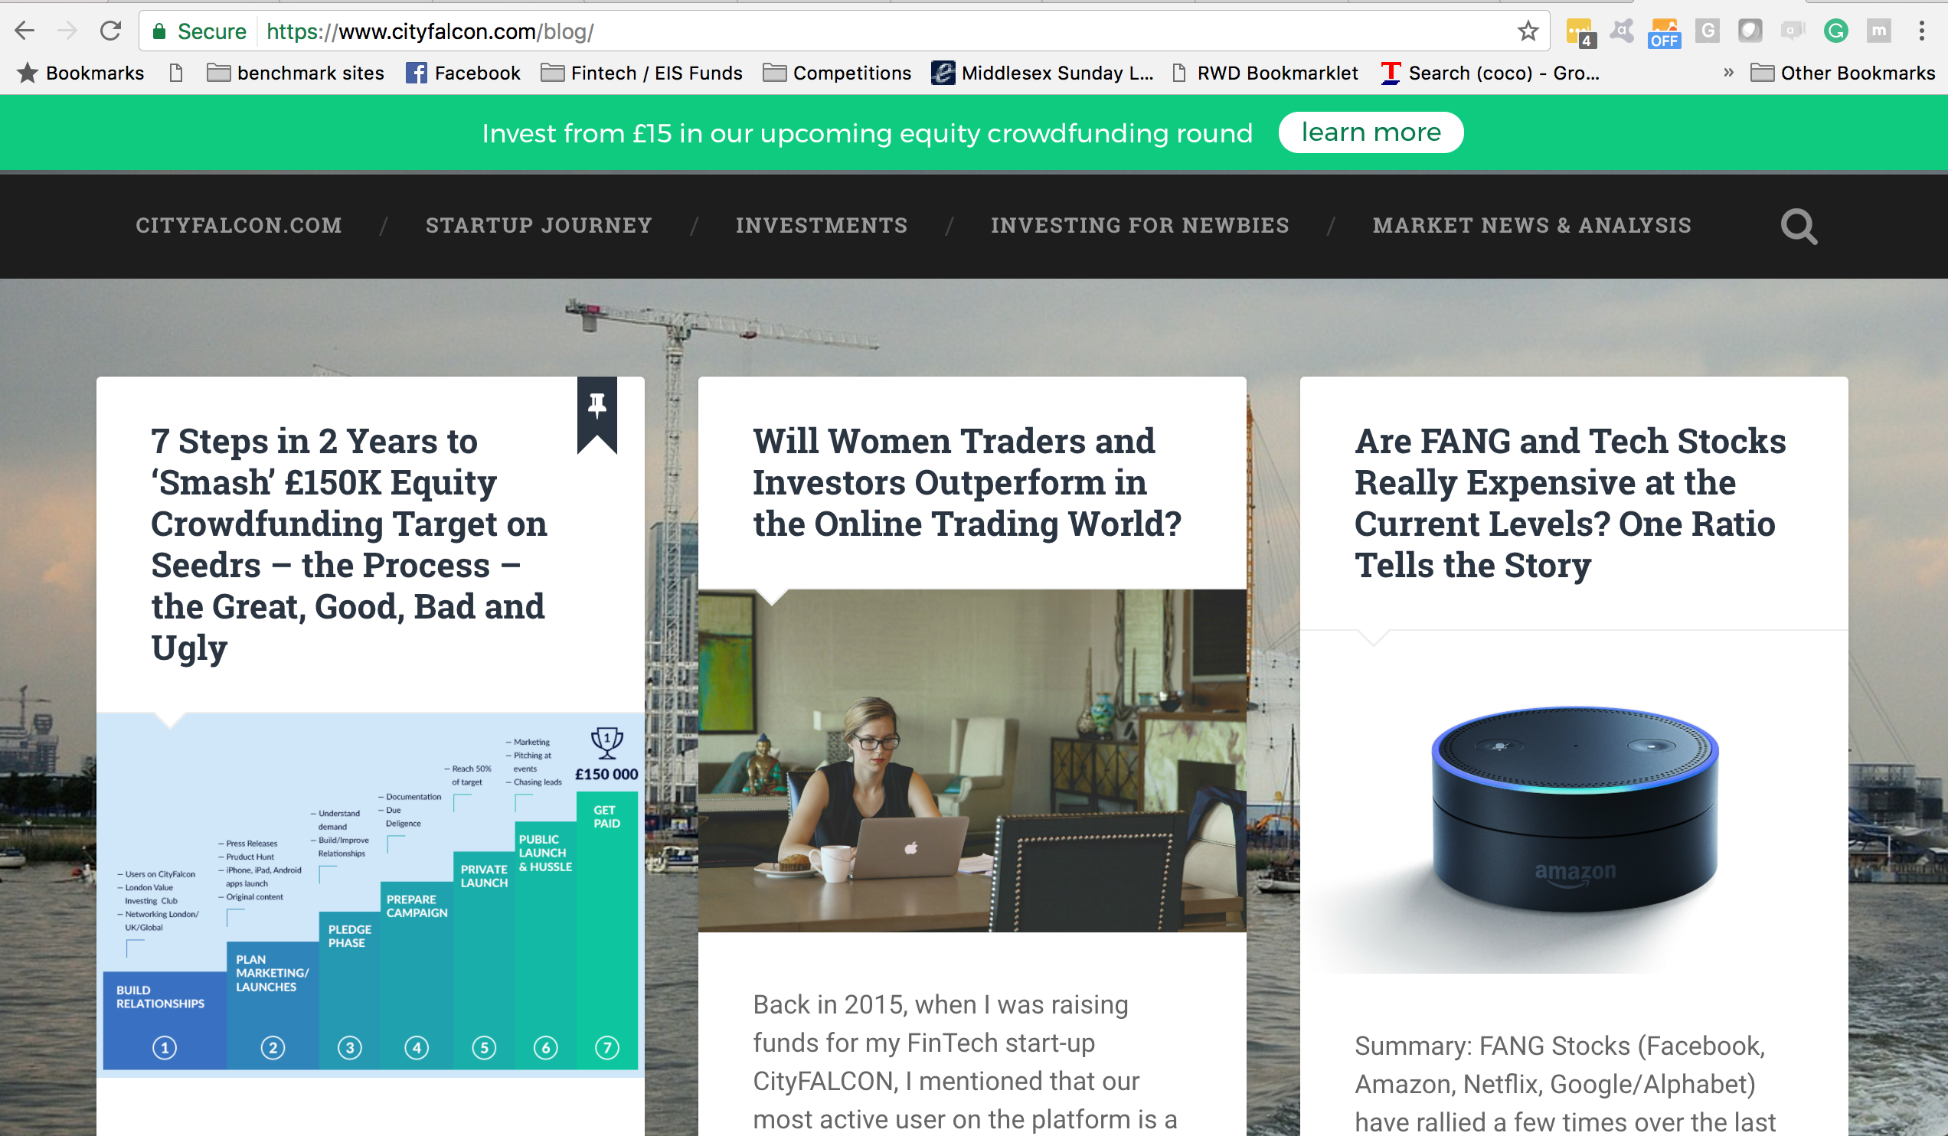

Slide 7
